Slide 1



22CSP72 – PROJECT WORK II PHASE I
A Hybrid ML-DL Framework for Early Dropout Prediction and Personalized Learning Interventions in E-Learning Systems
MENTOR :
Dr. M. Geetha
PRESENTED BY:
NISHANTHINI R – 23CSR148
RITHANYA R - 23CSR177
SRIDHAR K – 23CSL264
Associate Professor/CSE
Date: 20.07.2026
1

Slide 2
PROBLEM STATEMENT
Many students enroll in online courses but fail to complete them, reducing learner success and course completion rates.
Existing systems often identify at-risk students only after significant disengagement, limiting timely intervention.
Most existing approaches provide fixed recommendations that do not adapt to each student's learning behavior and progress.
Current systems focus only on predicting the current dropout risk and do not forecast future risk trends or provide proactive learning plans.
2

Slide 3
OBJECTIVE
Develop a hybrid Machine Learning and Deep Learning framework to predict student dropout at an early stage using behavioural and academic data.
Forecast future dropout risk trends using LSTM/GRU models to enable proactive identification of at-risk learners.
Generate personalized learning recommendations and structured learning roadmaps based on each student's learning behavior and predicted risk.
Improve learner engagement, retention, and course completion by providing adaptive and data-driven intervention strategies.
3

Slide 4
LITERATURE SURVEY
Title & Year | Methodology | Best Model | Performance | Limitations
Intelligent System for Personalized Interventions and Early Dropout Prediction in MOOCs (2022) | Deep Learning, Genetic Algorithm (GA), Hybrid Feature Selection | DL + GA | Accuracy: 92.4% | Limited temporal learning, No Explainable AI
Predictive Modeling for Student Dropout Using Ensemble Deep Reinforcement Learning (2026) | DDQN, LSTM, XGBoost, LightGBM, CatBoost | EDRL (DDQN + LSTM + Ensemble) | Accuracy: 95.6% | No Explainable AI, No Personalized Recommendation
3

Slide 5
LITERATURE SURVEY
A Machine Learning-Based Framework for Dropout Prediction and Personalized Recommendation in E-Learning Systems (2026) | CatBoost, KNN Collaborative Filtering | CatBoost | Accuracy: 93.0%F1-Score: 0.93AUC: 0.97 | Static recommendations, No future risk forecasting
Proposed Work (2026) | CatBoost, KNN, LSTM/GRU, SHAP, Adaptive Learning Roadmap | Hybrid ML-DL Framework | Expected to improve prediction accuracy, transparency, and learner retention | Overcomes limitations of existing systems
3

Slide 6
BASE PAPER SELECTION
BASE PAPER 1
Title: Intelligent System for Personalised Interventions and Early Drop-out Prediction in MOOCs
Publication Details: Computers and Education: Artificial Intelligence
Year: 2022
Best Model: Hybrid Feature Selection + Genetic Algorithm + Deep Learning
Accuracy: High prediction accuracy (using KDD Cup 2015 and XuetangX MOOC datasets)
Reason:
Proposes an intelligent system for early dropout prediction.
Uses Hybrid Feature Selection to identify important learning features.
Employs Genetic Algorithm to optimize model performance.
Provides priority-based personalized interventions for at-risk students.
Forms the foundation for our hybrid dropout prediction framework.
5

Slide 7
BASE PAPER SELECTION
BASE PAPER 2
Title: Predictive Modeling for Student Dropout in Online Courses Using Ensemble Deep Reinforcement Learning
Publication Details:
Year: 2026
Best Model: DDQN + LSTM + XGBoost + LightGBM + CatBoost (Ensemble)
Accuracy: High prediction performance using the OULAD dataset
Reason:
Uses Deep Reinforcement Learning (DDQN) for automatic feature selection.
Employs LSTM to capture temporal learning behavior.
Combines multiple ML models through ensemble learning for improved accuracy.
Achieves robust early dropout prediction.
Provides ideas for building an advanced hybrid ML-DL prediction model.
5

Slide 8
BASE PAPER SELECTION
BASE PAPER 3
A Machine Learning-Based Framework for Dropout Prediction and Personalized Recommendation in E-Learning Systems
Publication Details:
Year: 2026
Best Model: CatBoost + KNN Collaborative Recommendation
Accuracy: High prediction accuracy with personalized recommendation framework
Reason:
Uses CatBoost for efficient dropout prediction.
Generates personalized recommendations using KNN.
Identifies important student behavioral features.
Introduces peer-based recommendation for learning support.
Inspired our personalized intervention module.
5

Slide 9
RESEARCH GAP
Existing models predict student dropout but do not clearly explain the reasons behind the prediction.
Most approaches use either Machine Learning or Deep Learning alone, limiting prediction performance.
Current intervention methods provide generic or static recommendations instead of adaptive learning support.
There is no unified framework that combines Hybrid ML-DL, Explainable AI, and personalized learning interventions.
6

Slide 10
NOVELTY
Develop a Hybrid CatBoost–BiLSTM model for accurate early dropout prediction by combining Machine Learning and Deep Learning.
Integrate SHAP-based Explainable AI to provide clear reasons behind each student's dropout prediction.
Design an Adaptive Personalized Learning Intervention that generates customized learning paths based on individual student performance.
6

Slide 11
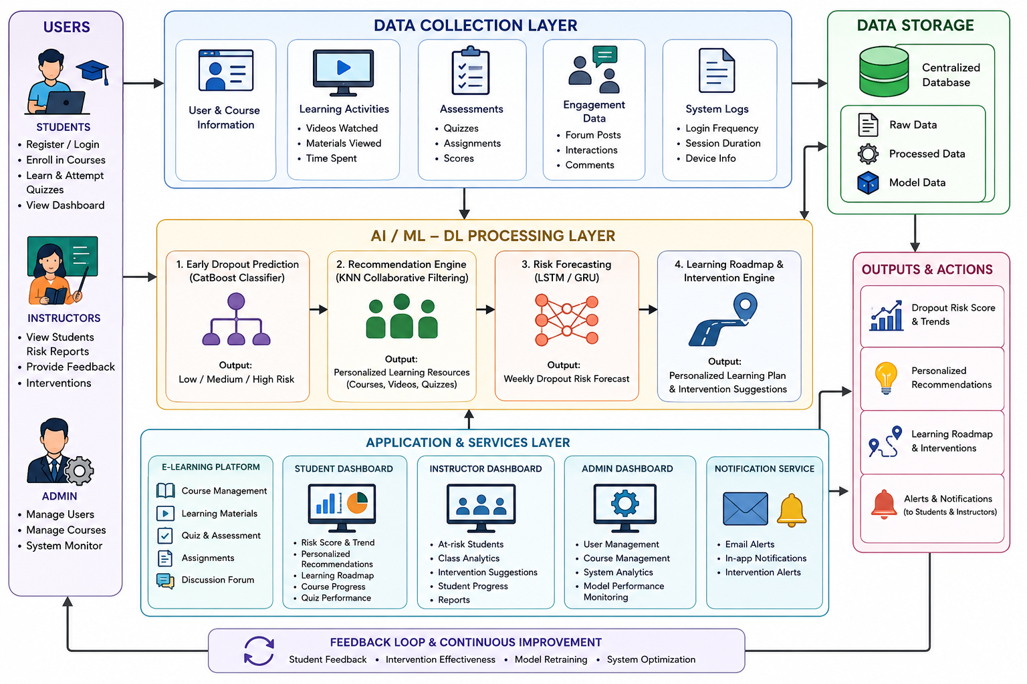
ARCHITECTURE DIAGRAM
6

Slide 12
PROPOSED WORK WITH PLANNED INNOVATION
Proposed Work:
Early dropout prediction using CatBoost.
Personalized recommendations using KNN.
Weekly risk forecasting using LSTM/GRU.
Interactive student & faculty dashboards.
Planned Innovation:
SHAP-based Explainable AI.
Personalized learning roadmap.
Adaptive intervention optimization.
6

Slide 13
MODULES OF THE PROJECT
1. User Registration & Course Management
2. Student Learning & Activity Tracking
3. Data Collection & Preprocessing
4. Early Dropout Prediction
5. Personalized Recommendation System
6. Weekly Risk Forecasting
7. Personalized Learning Roadmap & Student Dashboard
8. Admin Dashboard & Adaptive Intervention
6

Slide 14
METHODOLOGY
Student Behavioral Dataset
↓
Data Preprocessing
↓
Feature Engineering
↓
CatBoost Classifier (Early Dropout Prediction)
↓
KNN Recommendation Engine
↓
LSTM (Weekly Risk Forecasting)
↓
Personalized Learning Roadmap ↓
Adaptive Intervention
↓
Performance Evaluation
6

Slide 15
EXPECTED OUTCOME
Develop an intelligent system for accurate early prediction of student dropout risk using a Hybrid ML-DL framework.
Provide personalized learning recommendations and study roadmaps to improve student engagement and learning outcomes. Forecast future dropout risk trends using deep learning models, enabling proactive intervention before students disengage.
Improve student retention, course completion rates, and overall academic performance through adaptive and data-driven interventions.
6

Slide 16
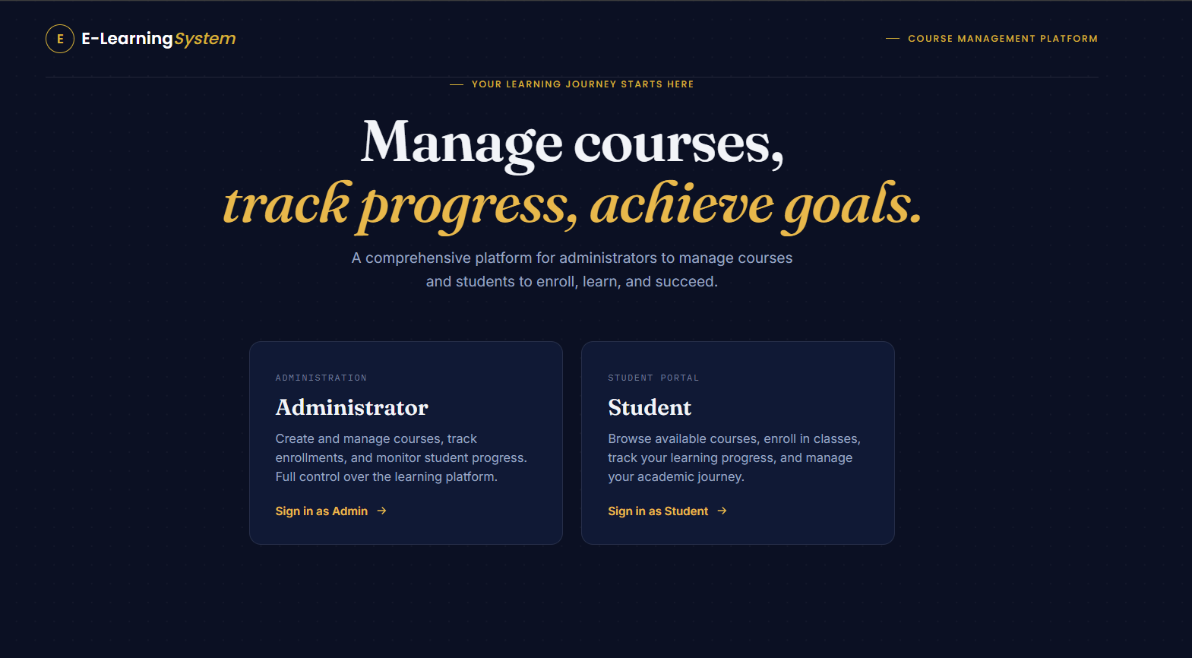
IMPLEMENTATION
6

Slide 17
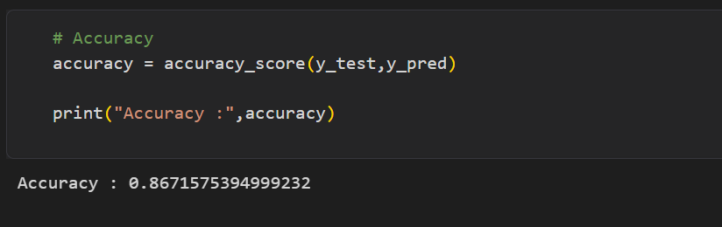
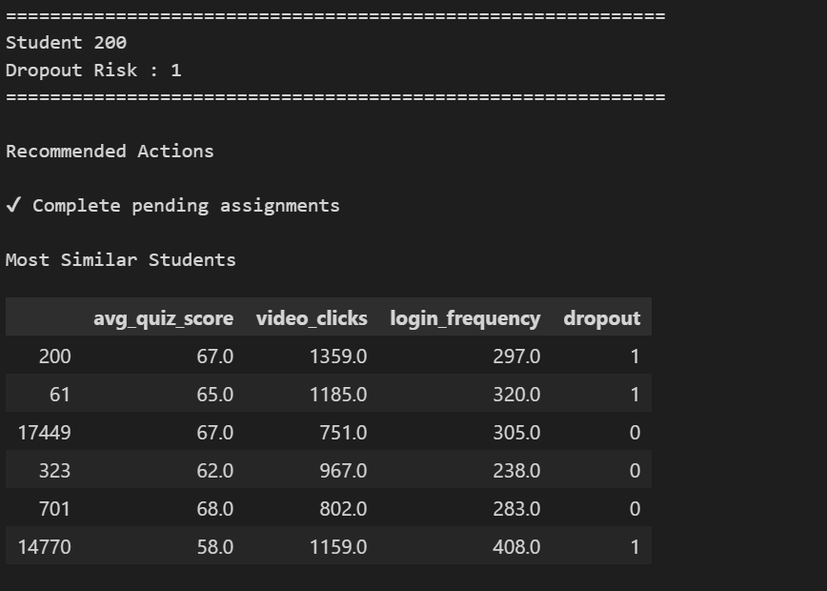
IMPLEMENTATION
6

Slide 18
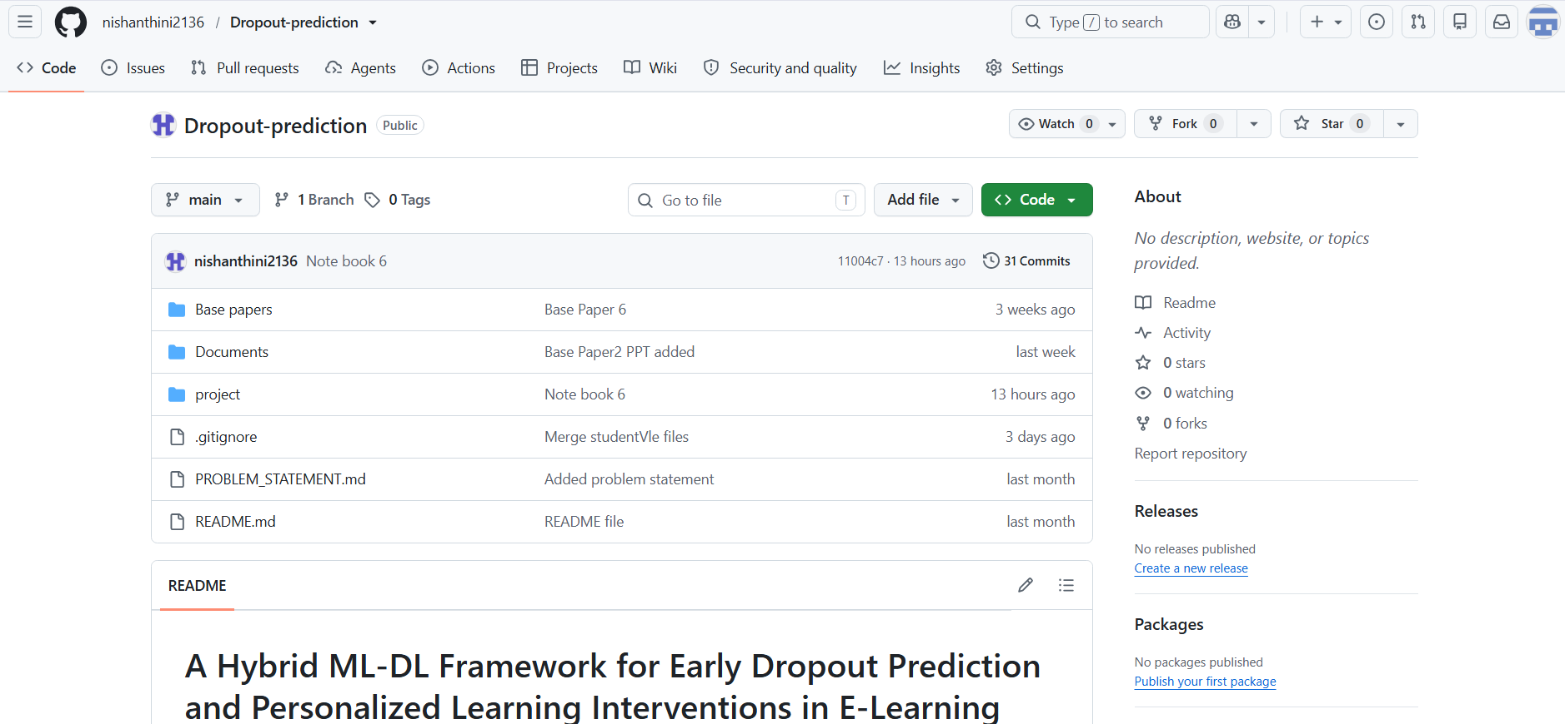
GIT DOCUMENTATION
6

Slide 19
THANK YOU
7

